Slide 1
Automated Parking Systems
Robotics 7 – The World Is Data

Slide 2
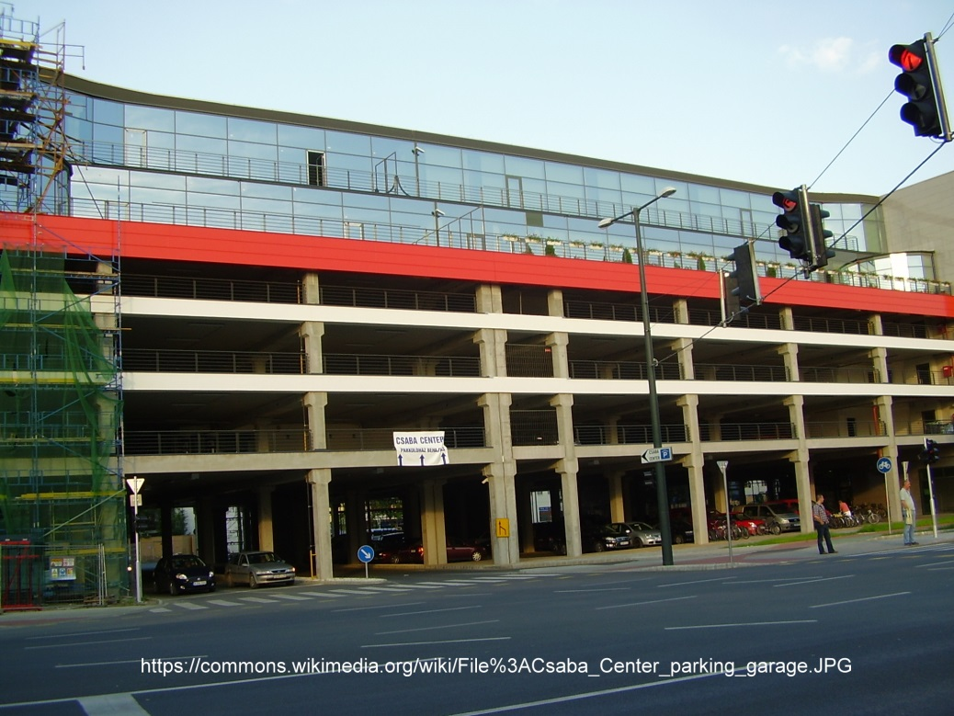
Parking Problems
Urban areas often have many parking issues because of limited space and money.
Of course, citizens would rather have the city build parks or more exciting places than lots. Their opinions on building more parking lots are usually negative.
Parking lots and areas can also cause temporary jams if many people try to enter or exit at the same time.

Slide 3
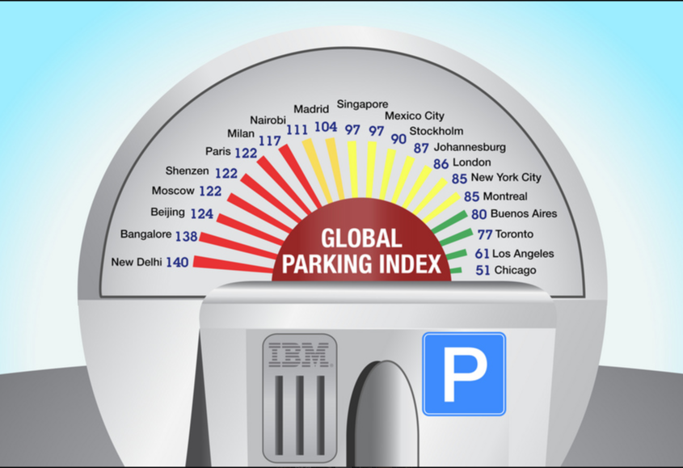
Top Ten Worst Cities for Parking
1) New Delhi, 2) Bangalore, 3) Beijing, 4) Moscow, 5) Shenzhen, 6) Paris, 7) Milan, 8) Nairobi, 9) Madrid, and 10) Singapore
The IBM Parking Index considers the following key issues when listing the worst cities for parking:
amounts of time spent looking for a place to park
how often drivers do not find a place to park
numbers of disagreements over parking spots
the number of parking tickets written for illegal parking
the number of parking tickets received
http://www-03.ibm.com/press/us/en/pressrelease/35515.wss

Slide 4
Common Design Issues for Parking Garages
Geography: Where to build it. Climate and seismic conditions can affect where and how the parking area can be built.
Cost: There are many issues related to cost. The size of the footprint (the parking area and any traffic it causes) within an urban or even suburban setting can increase the cost of construction. There are also aesthetic (beauty) costs because parking areas are rarely beautiful. Construction and labor costs can also affect the total price of the garage.
Total Parking Spaces: If there are too many spaces, the lot is probably too big (bigger footprint). Then many spaces might go unused. If there are always spaces to park in, people will want to pay less for parking.
Number of Parking Levels: The size of the parking area can be smaller (narrower) if it is taller (more levels). The cost to build a parking garage up (higher) is usually cheaper than to build a parking garage or area out (wider, over more space). However, drivers do not want to drive up many levels to park. They would prefer to have their cars close to where they are going (on the ground).

Slide 5
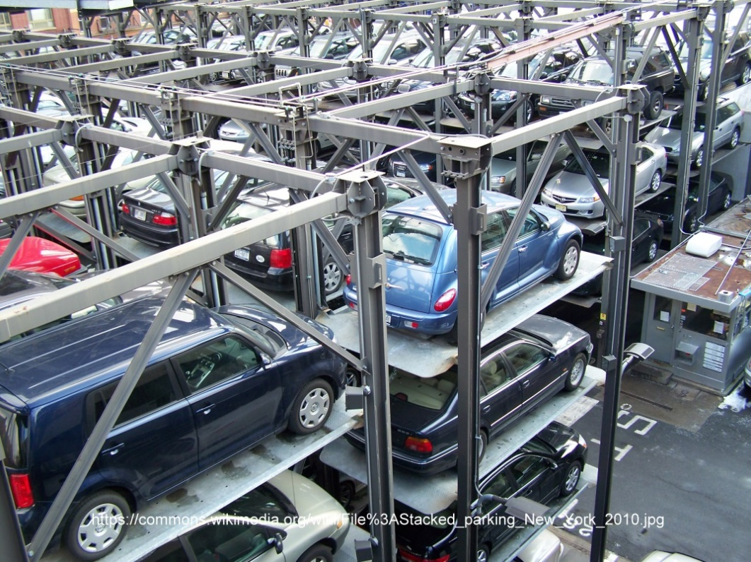
Stacked Parking
Recent Parking Solutions
The picture on the right is an example of stacked parking that is used in New York City in the United States.
Cars are driven onto platforms which are raised and lowered for access.
This design can be difficult with New York City’s snowy winter weather.

Slide 6
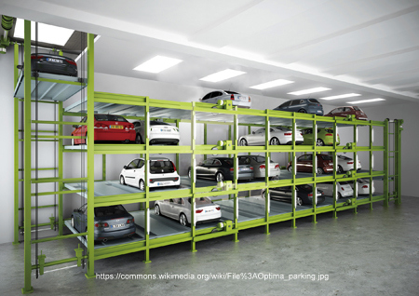
Elevator Parking
Recent Parking Solutions
The example in the picture on the right utilizes only underground parking.
This design keeps cars out of the weather.
The robotic lift lowers the car into the underground lot and then also moves it horizontally for storage.

Slide 7
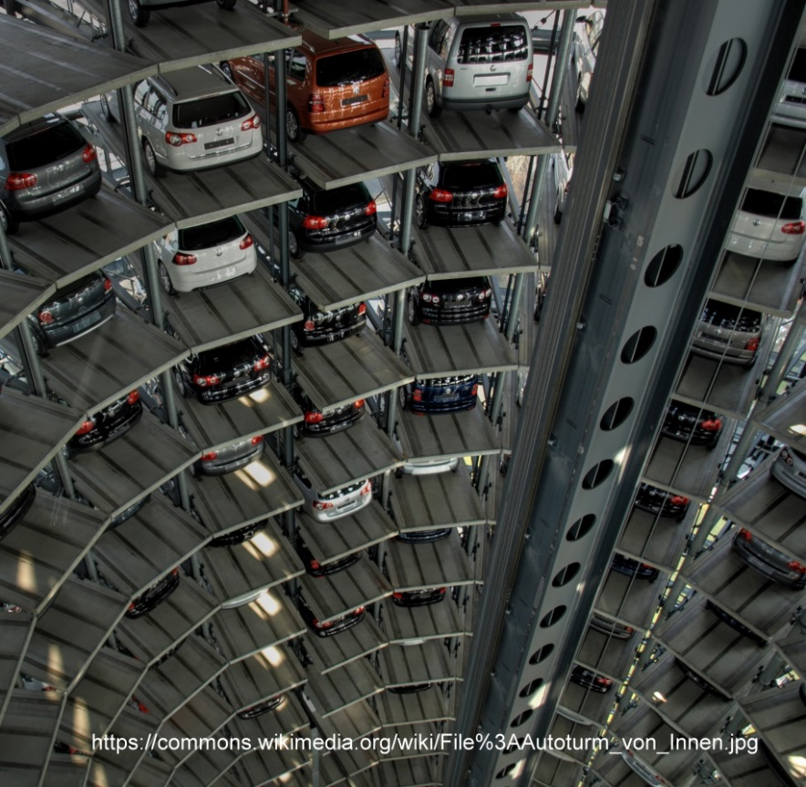
Robot Rotunda Parking
Recent Parking Solutions
The picture on the right is a parking tower that was designed by Skyline Inc. in Germany.
The overall shape of the tower is a cylinder.
This design uses a robotic arm in the center of the tower to deliver cars to storage locations around the walls of the tower.

Slide 8
What does an automated garage need to do?
You have seen three different examples of recent parking solutions.
What do all automated garages need to do in order to work properly?

